Slide 1
Understanding
Career Aspirations
of Gen-Z
Presented by Varun S Patil

Slide 2
CONTENTS
Introduction
Initial Research
Data Collection
Data Cleaning
Dashboards
Insights

Slide 3
Problem Statement
Gen-Z
Personal Traits
Preference
Career
Which one to choose?
Really Job ?
How?

Slide 4
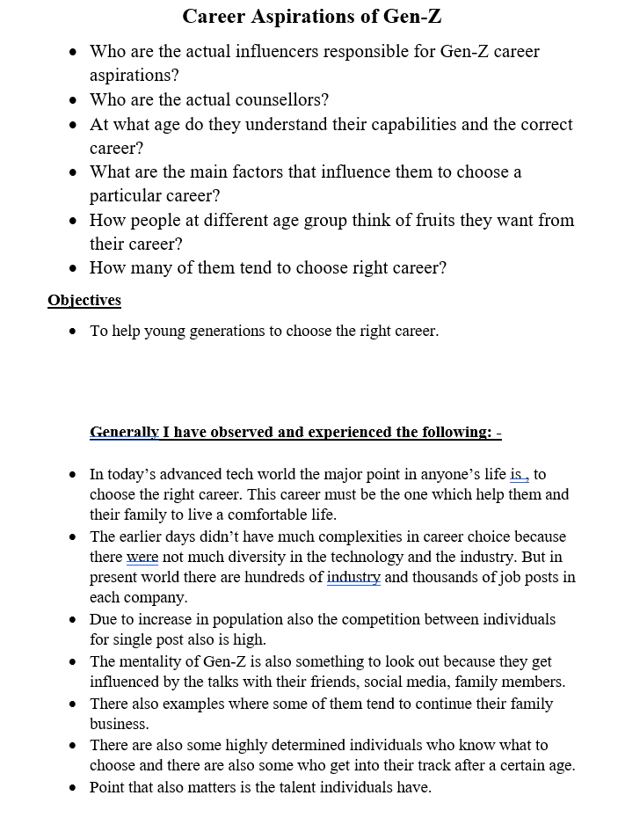
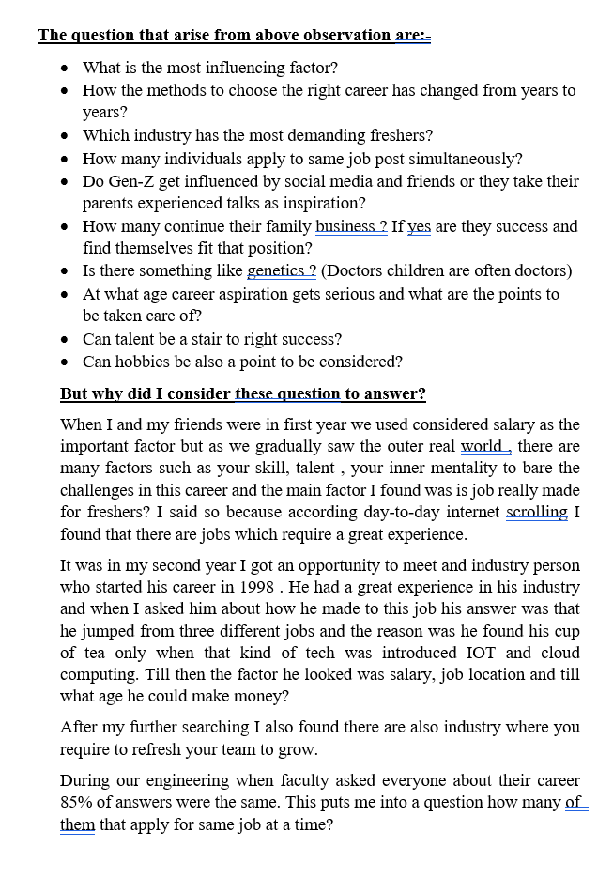
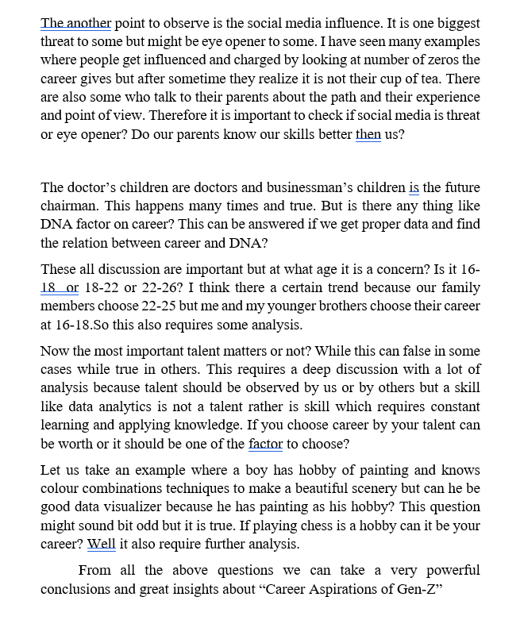
SNIPPETS OF INITIAL DOCUMENTATION

Slide 5
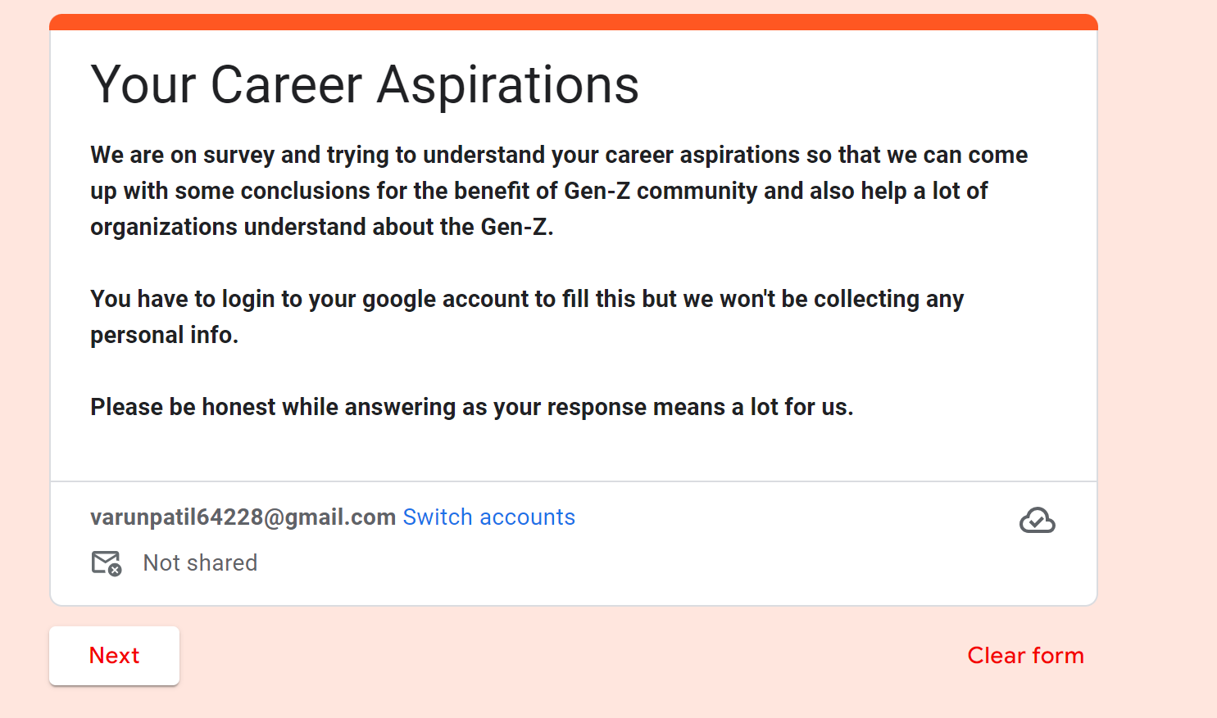
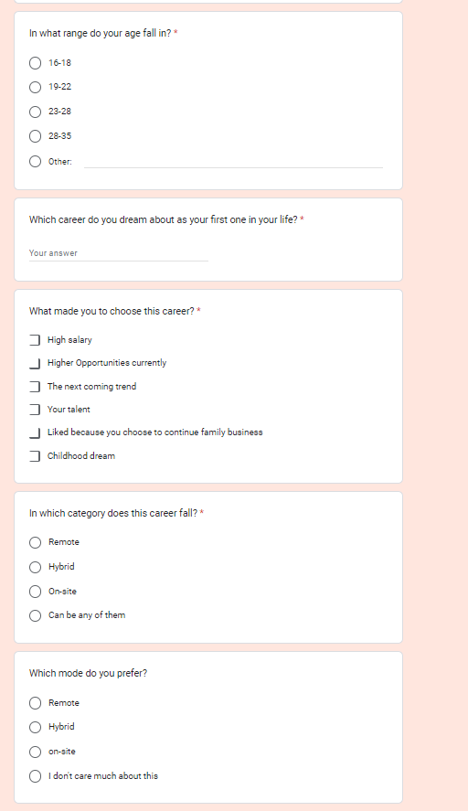
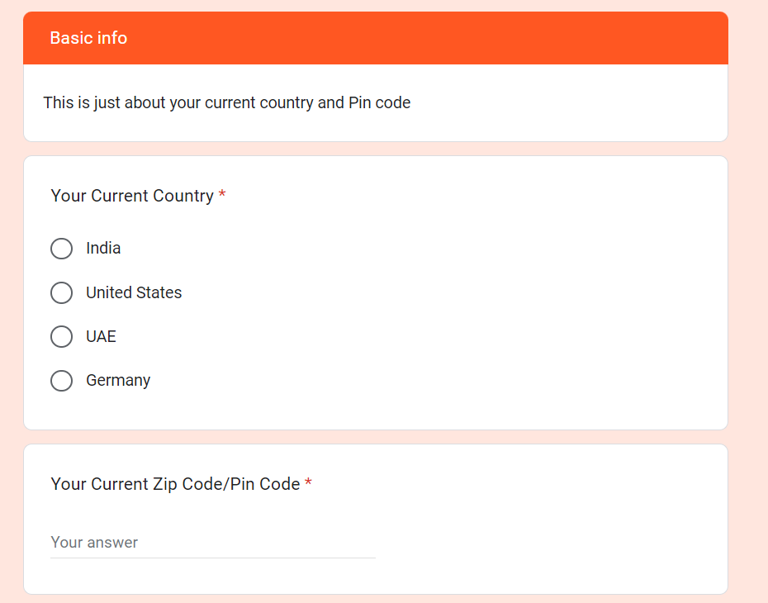
DATA COLLECTION PROCESS AND PROOF

Slide 6
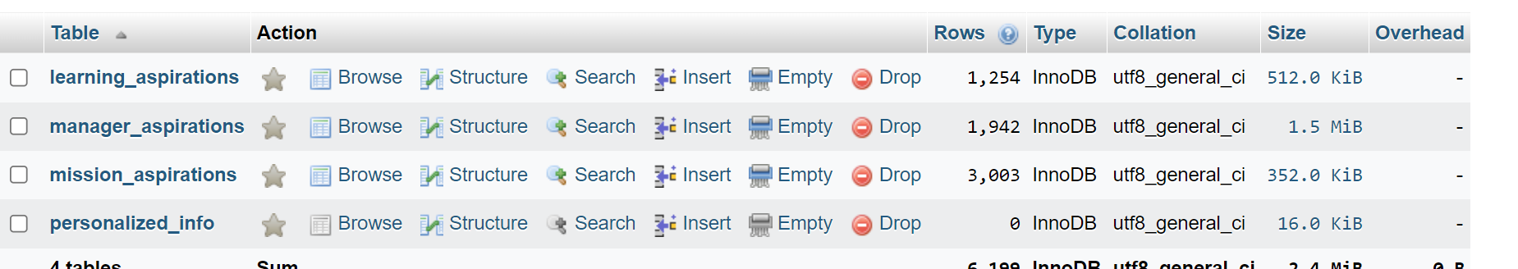
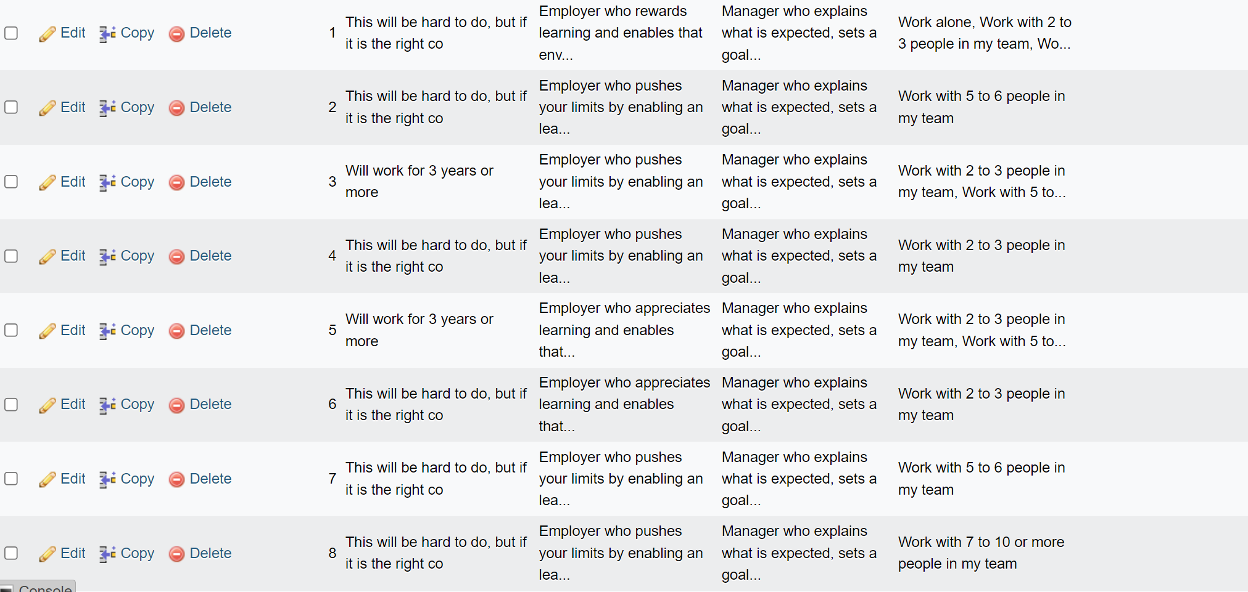
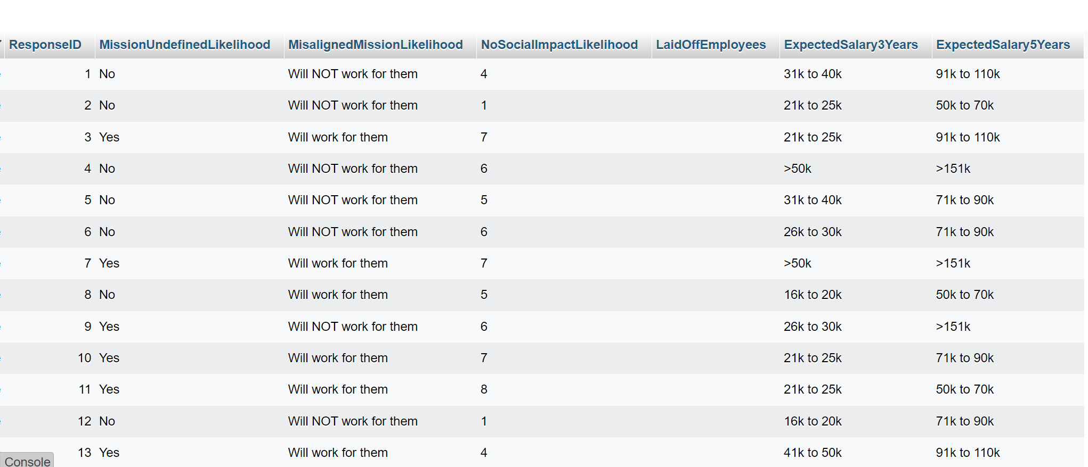
DATA CLEANING PROCESS AND PROOF

Slide 7
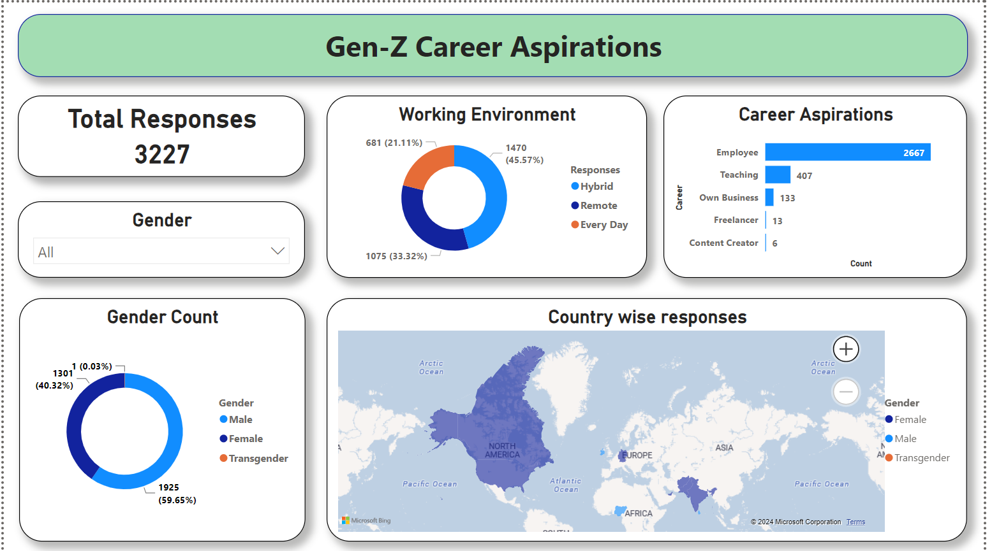
GENERAL DASHBOARD

Slide 8
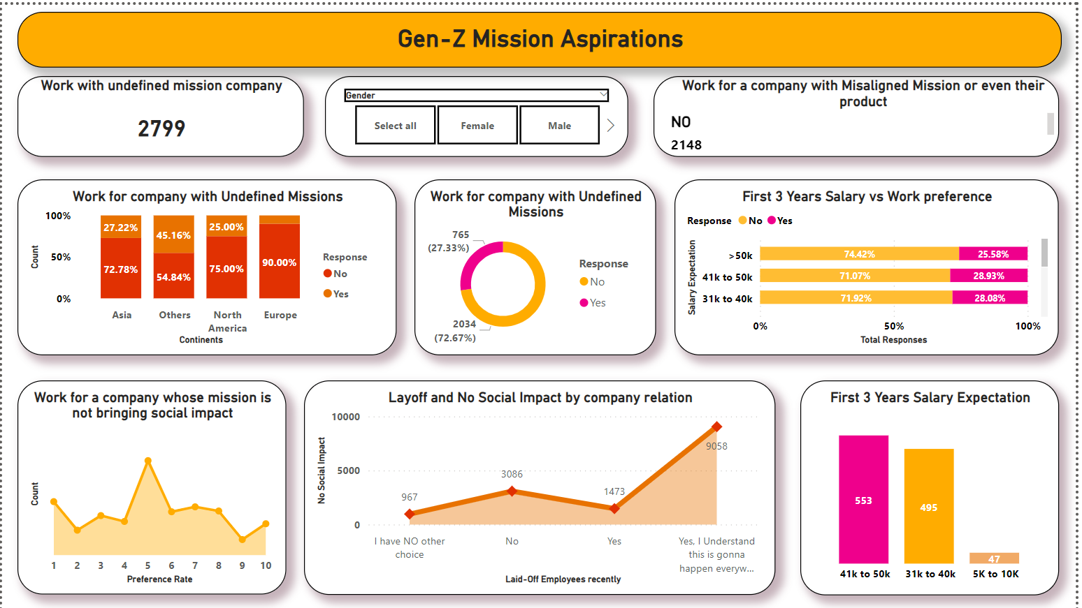
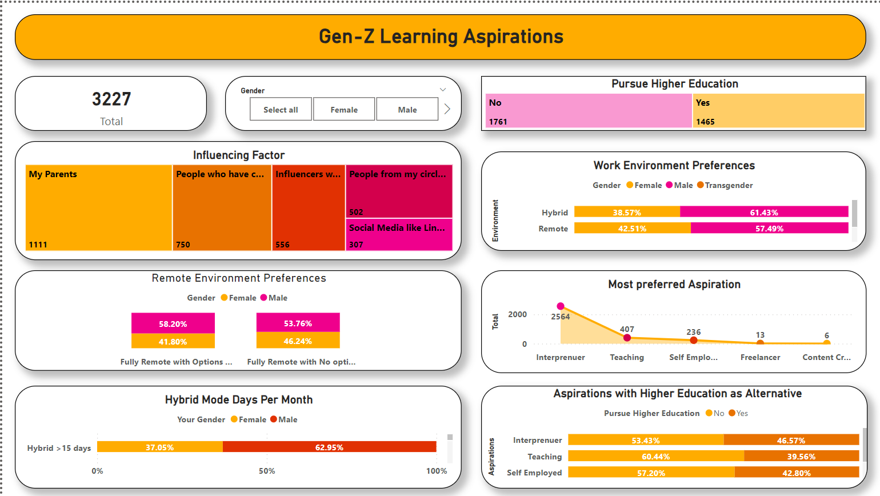
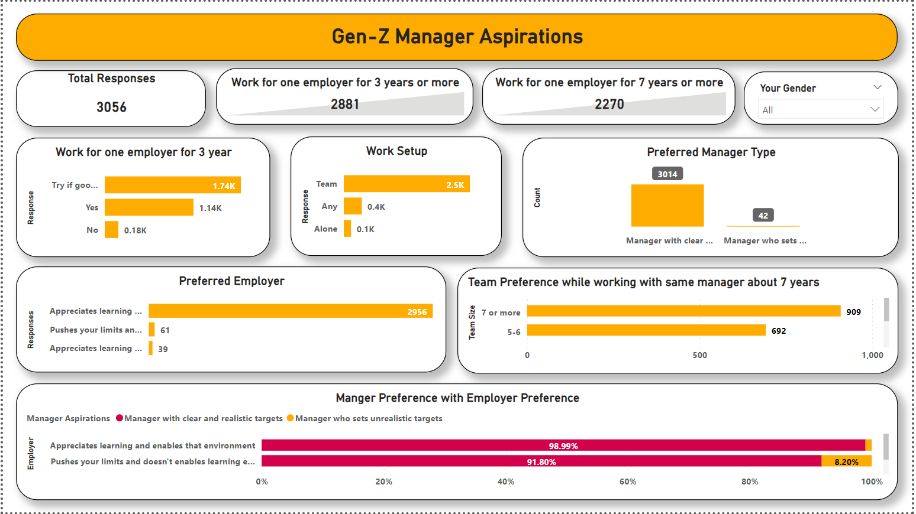
FUNCTIONAL DASHBOARDS

Slide 9
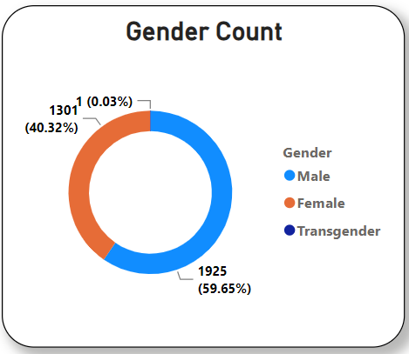
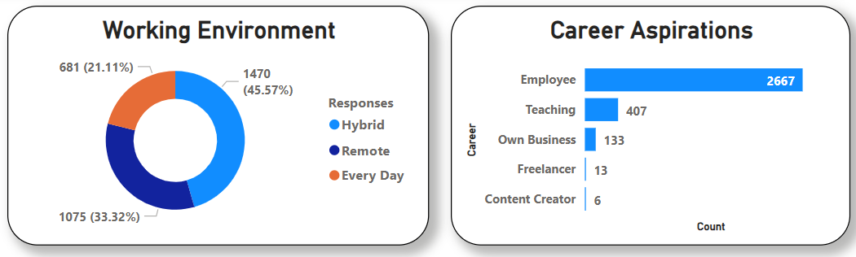
Insight -1

Slide 10
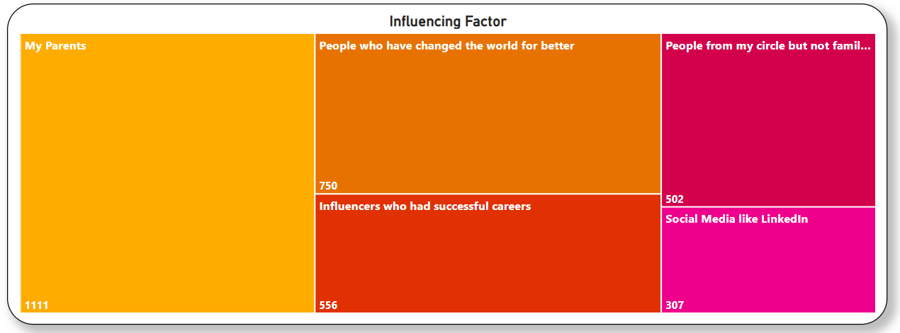
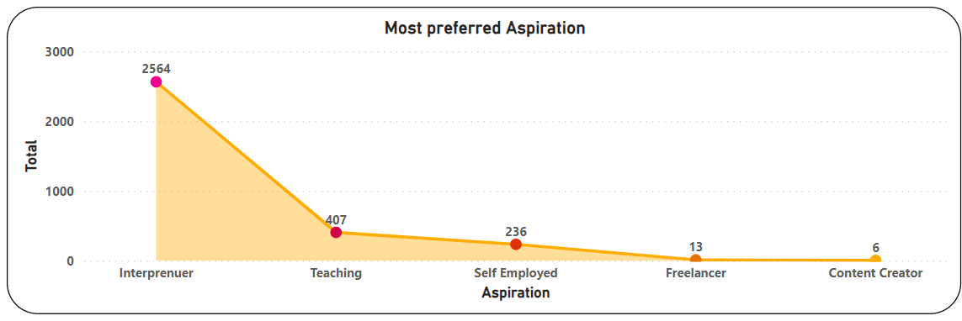
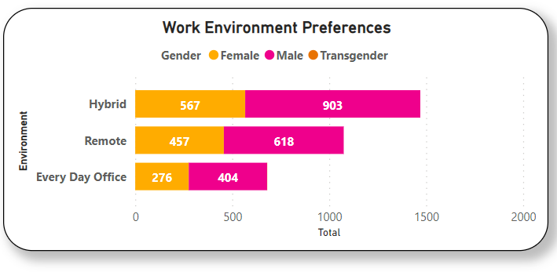
Insight -2

Slide 11
CONCLUSION
Gen Z is increasingly drawn to interpreneurship within a hybrid work environment. Influenced predominantly by parental guidance and a select few successful role models, they are also significantly impacted by social media, which shapes their entrepreneurial aspirations and decision-making processes.

Slide 12
"Gratitude is the key that unlocks the door to opportunity. Thank you for the chance to grow, learn, and thrive."
Thank You

